Slide 1
Aging Analysis: Brainstorming
Andrew Zalesak & Melissa Schnure

Slide 2
Objectives
Characterize how the PLWH population may age in the next decade
Inspect differences between states

Slide 3
Methods
Run state-level model simulations out to 2040 with no intervention
Will be re-calibrating with a smoother spline function for sexual transmission rates to keep incidence projections reasonable
Later, we may introduce an intervention to compare to baseline

Slide 4
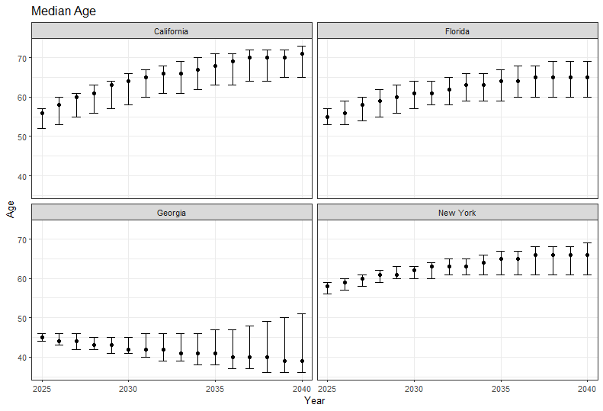
Results: Median Age

Slide 5
Results
Measure | Number PLWH Over 55 Years |  |  |  | Proportion PLWH 55 Years |  |  |  | Median Age
Outcome | Prevalence |  | Incidence |  | Prevalence |  | Incidence |  | Prevalence |  | Incidence
Year | 2025 | 2040 | 2025 | 2040 | 2025 | 2040 | 2025 | 2040 | 2025 | 2040 | 2025 | 2040
CA | 74500 | 103725 | 459 | 439 | 0.53% | 0.76% | 0.14% | 0.21% | 56 | 71 | 32 | 36
 | [67434-78111] | [91815-110442] | [364-636] | [238-835] | [0.47-0.55%] | [0.65-0.83%] | [0.11-0.18%] | [0.15-0.31%] | [52-57] | [65-73] | [31-34] | [32-42]
FL | 65732 | 98583 | 671 | 444 | 0.51% | 0.67% | 0.19% | 0.28% | 55 | 65 | 35 | 40
 | [61490-69998] | [87783-112236] | [551-830] | [324-825] | [0.48-0.54%] | [0.57-0.75%] | [0.16-0.23%] | [0.17-0.35%] | [53-57] | [60-69] | [33-36] | [33-44]
GA | 23218 | 31567 | 356 | 280 | 0.35% | 0.36% | 0.14% | 0.18% | 45 | 39 | 33 | 34
 | [21335-24160] | [27150-40188] | [311-419] | [195-471] | [0.33-0.37%] | [0.3-0.49%] | [0.13-0.16%] | [0.14-0.24%] | [44-46] | [36-51] | [31-34] | [31-38]
NY | 66908 | 69530 | 315 | 281 | 0.55% | 0.62% | 0.20% | 0.22% | 58 | 66 | 34 | 35
 | [64017-68813] | [61541-76228] | [266-445] | [201-668] | [0.53-0.56%] | [0.56-0.69%] | [0.17-0.25%] | [0.12-0.33%] | [56-59] | [61-69] | [33-36] | [31-40]

Slide 6
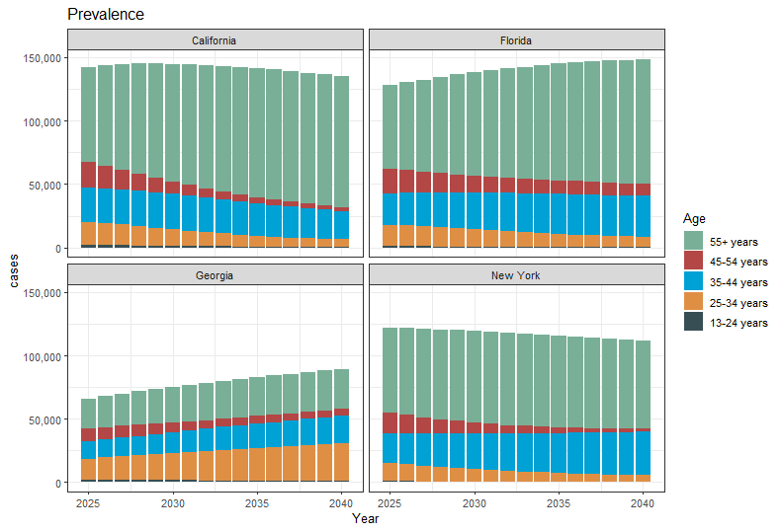
Results: Prevalence Trends by Age

Slide 7
Questions for You
Should we look at all U.S. states, or deep-dive into a few?
Interventions?
Is the interaction with race/sex worth exploring?

